Slide 1
Bitcoin
Presented By: Kaitlyn Corrigan, Tia Delseni, Michael Cuiffo, Jillian Swiderski, and Angelina Lopez

Slide 2
Agenda
1
History of Bitcoin
2
Description of Bitcoin:
What it does, How it works, Positive effects, & Negative effects.
3
Future of Bitcoin: Where is it headed?

Slide 3
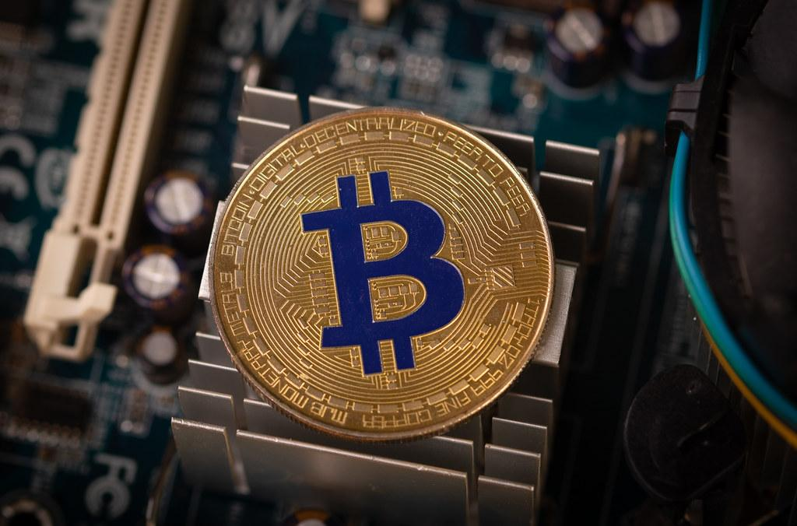
History of Bitcoin
Introduced in 2008- Satoshi Nakamoto
Bitcoin P2P e-cash paper & "Bitcoin: A Peer-to-Peer Electronic Cash System."
Officially launched in 2009
First Bitcoin Economic Transaction - May 22, 2010
Ethereum, Litecoin
Price History
2011: $1-$31
2013 : $200
2017: $19,650
Today : about $60,000

Slide 4

How it Works
A cryptocurrency that runs and relies on a blockchain.
A person who wants bitcoin should download a bitcoin wallet to their personal device. This secures your bitcoin.
Block chains help Bitcoin wallets calculate a person’s balance that they are able to send and receive Bitcoin knowing it is verified by the person sending or receiving it.
The Bitcoin wallet keeps a piece of data that is called “private key”. This is used for mathematical proof that it is the actual owner sending from the wallet.
Mining is also another system that helps confirm the transactions of Bitcoin.

Slide 5

Negative Effects
Bitcoin is NOT always accepted
Risk of the unknown
“Built in Deflation”
Needs Converting
Value Fluctuation

Slide 6

Positive Effects
No banking fees/taxes
Payments are mobile
Cannot be stolen
Freedom with money/no government involvement

Slide 7
Future of Bitcoin
Become a real currency
Price projected to be $500,000 by 2030
More types of cryptocurrencies
Introduction of more virtual wallets
Less use of paper money

Slide 8
Review
Launched in 2009 by Satoshi Natamoko
“Electronic Cash System”
Relies and runs ond blockchain
Not always accepted
Lots of unknown risk
No bank fees
Can’t be stolen

Slide 9
Questions?

Slide 10
References (APA 7)
Disadvantages | Bitcoin. (2010). Stanford.edu; Bitcoin. https://cs.stanford.edu/people/eroberts/cs181/projects/2010-11/DigitalCurrencies/disadvantages/index.html
How does bitcoin work? Bitcoin. (n.d.). Retrieved October 18, 2021, from https://bitcoin.org/en/how-it-works.
The History of Bitcoin | investing | US news. (n.d.).
https://money.usnews.com/investing/articles/the-history-of-bitcoin
Reiff, N. (2021, August 9). What are the advantages of paying with Bitcoin? Investopedia. Retrieved October 18, 2021, from https://www.investopedia.com/ask/answers/100314/what-are-advantages-paying-bitcoin.asp.
Tragett, T “Bitcoin Price Prediction for 2021 to 2025, 2030 and 2050.”retrieved from
https://libertex.com/blog/bitcoin-price-forecasts.

